Slide 1


Final Python Data Project
World Happiness vs. Global Terrorism

Slide 2


Outline
Data Description
ERD
Outliers & Missing Data
Important Statistics
Visuals
Conclusion

Slide 3
Datasets Description
Happiness Index
https://www.kaggle.com/mathurinache/world-happiness-report?select=2017.csv
Source: World Happiness Report
“The World Happiness Report is a landmark survey of the state of global happiness that ranks 156 countries by how happy their citizens perceive themselves to be. The World Happiness Report 2020 for the first time ranks cities around the world by their subjective well-being and digs more deeply into how the social, urban and natural environments combine to affect our happiness. For my project I used data from 2017 in order to match the year with the Global Terrorism Dataset. “
Global Terrorism
https://www.kaggle.com/shubhamsharma99/global-terrorism
Source: Global Terrorism Database (GTD)
“The Global Terrorism Database (GTD) is an open-source database including information on terrorist events around the world since 1970 (I used data from 2017). Unlike many other event databases, the GTD includes systematic data on international as well as domestic terrorist incidents that have occurred during this time period and now includes over 190,000 cases. For each GTD incident, information is available on the date and location of the incident, the weapons used and nature of the target, the number of casualties, and -- when identifiable -- the identity of the perpetrator.”

Slide 4
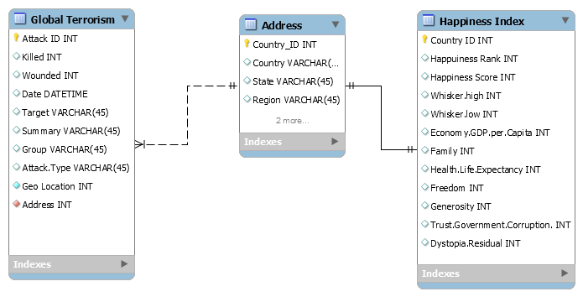
ERD
This is an ERD for my Datasets. I have created one table for Global Terrorism, Address and Happiness Index. I have connected the two datasets through Country name/ID. A Terror attack can happen more than once in the same location. A country only has one happy index.

Slide 5
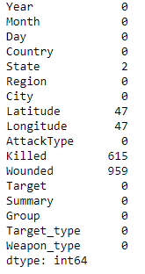
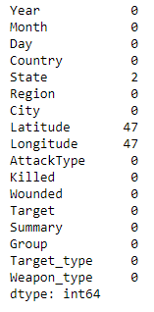
Outliers and Missing Data
Happiness Index had no missing data. Global Terrorist was missing values in Killed and Wounded variables. Since I was going to analyze them, I have added the min value in the column to replace the missing values. Since I was not going to use longitude and latitude, I left them as missing. I did not want to delete any value rows as they are important in my analysis.
There were some outliers in Happy index and Global Terrorism datasets but since they are all actual and important values, I did not delete them or excluded them from my analysis.
Missing values in Global Terrorism Dataset

Slide 6
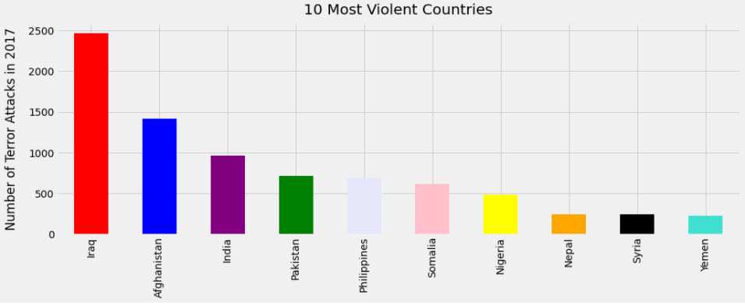
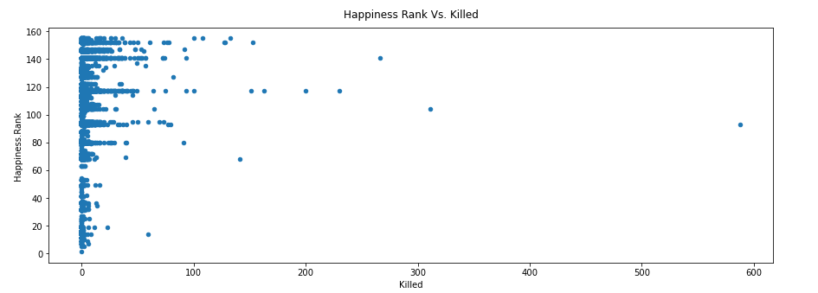
Important Statistics
Top 10 Countries with the highest Terror Attacks
There were a total of 155 Happiness Ranks, with a mean of 105 and a standard deviation of 32. The average Happiness Score a country received was 4.49 with a min of 2.7 and a max of 7.5. There was a total of 10,661 terror attacks with an average of 1,038 and a standard deviation of 885 attacks. On average there were 2 people killed and 2 people wounded during a terror attack. The largest attack had 588 deaths which happened in Samalia on 10/14 with additional 316 wounded.
The visual on the left shows the top 10 countries, we saw that Iraq had the most terror attack with about 2, 466 in total in 2017. Meanwhile it only held 117 Happiness Rank out of 155 ranks. Followed by Afghanistan with 1,414 terror attacks with a 141st Rank.
From the scatter plot we can see that on average countries with a lower Happiness rank had higher deaths due to terror attacks.
Happiness Rank vs Terror Deaths

Slide 7
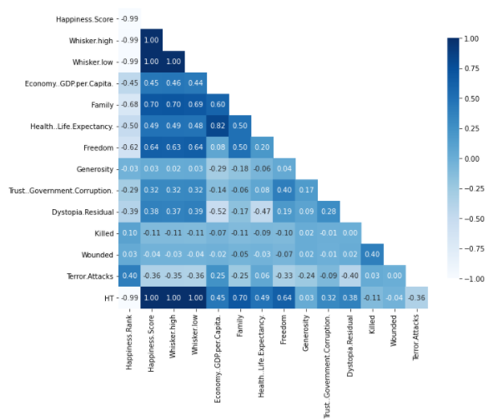
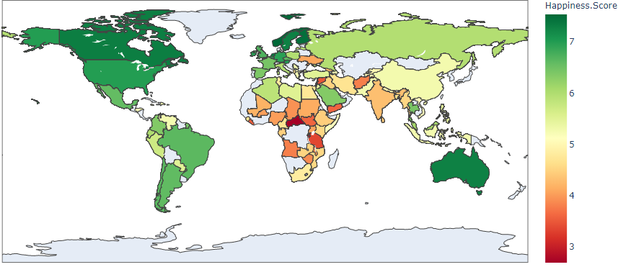
Visuals
Interactive Map Visual, showing a color array of counties by their happiness score. You can hover over countries to see their Terrorism Index as well in Jupiter Notebook.
Sudan had the lowest score of 2.6.
Correlation heatmap Graph between all quantitative variables in the merged Dataframe

Slide 8
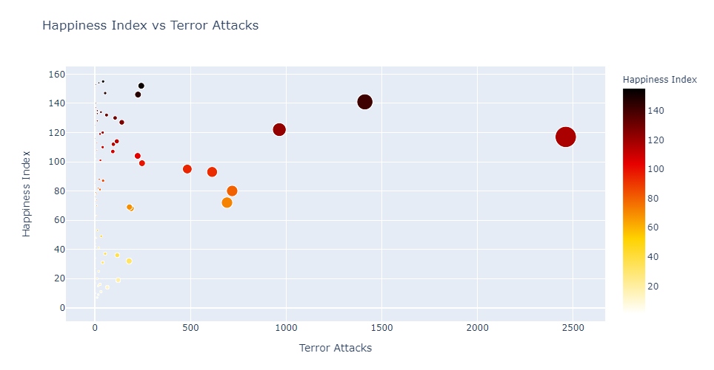
Conclusion
Is there a relationship between Happiness Index of a country and Terror Attacks?
From the scatter plot graph, we could see that Terror Attack had a small moderate correlation of .40 with Happiness Rank and Score of a country, which could indicate that lower happiness rank countries have more terror attacks. Furthermore, Terror attacks had moderate negative correlation with Happiness Score, Freedom and Dystopia Residual. This could be an indicator that countries with more government control, less freedom and more totalitarian regime have higher numbers of terror attacks. Additionally, from the scatterplot we saw that lower rank countries had more deaths from terror attacks. Lastly, the top 10 countries in the bar graph had low Happiness Ranks, which again demonstrates that Terror Attacks are more common in unhappier countries.

